Slide 1
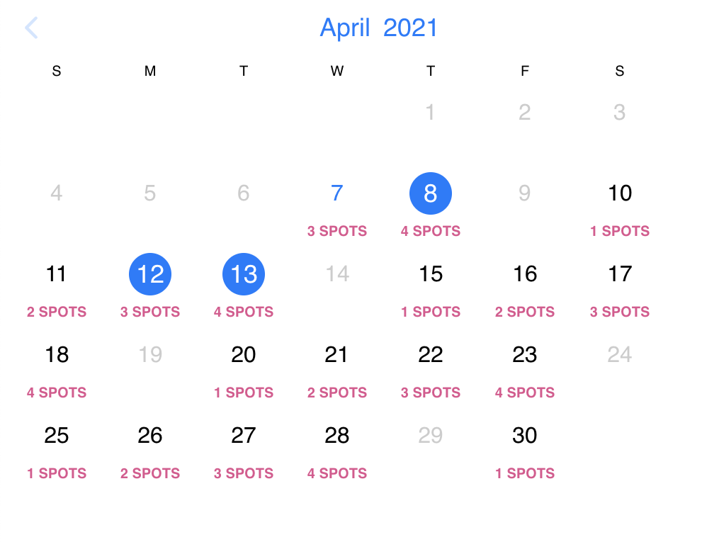

Calendar Project
Team 9

Slide 2
Calendar Project Introduction
Goal
To create a scheduling platform that utilizes Zoom for meetings. The idea behind this is to create our own version of Calendly.com.
Overview
The website is to be used by at least one Administrator and one User. Registration for both User and Admin will be required for login.
Administrator plays the role of secretary/clerk.
User plays the role of a manager or professor.
Administrator functions – manages User’s daily availability, appointment types and respective time ranges for each appointment type, suggestions of appointments/reoccurring appointments and who attends.
User functions – request administrator to schedule new appointments with the idea of “Please find a time I can meet with so and so”, change scheduling settings, setup/change Zoom account, view/approve/deny appointment requests sent by Administrator and send out Zoom email confirmation.

Slide 3
Objectives
Account login for user and administrator
For the administrator to specify appointment types for different hours
For the administrator to specify days of availability and reoccurring events
For the administrator to be able to specify the time range/time/number of bookings for each appointment type
For the user to have the ability to view the calendar and select days to view appointment availability
To have a grayed out section that the user cannot see for times that are unavailable
For the appointments to be connected to Zoom API for booking time and information
For the user to be able to delete appointments

Slide 4
Technologies Used
JavaScript base language
Node.js JavaScript runtime environment
React JavaScript library installed using Node.js
Replit.com online IDE
Discord for team discussion
Lucidchart
For creating diagrams

Slide 5
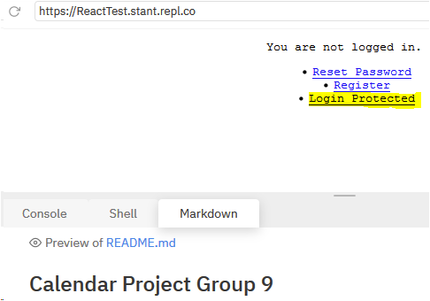

Initial Website Look

Slide 6
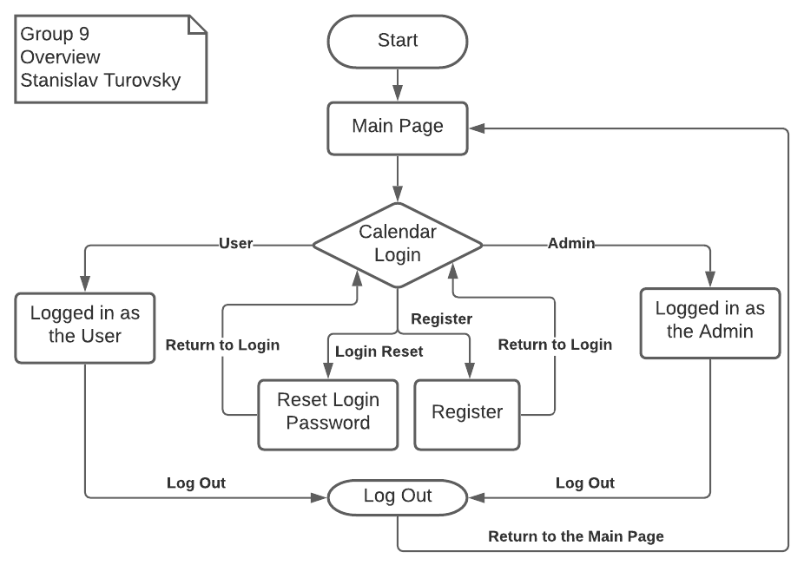
Overview Diagram

Slide 7
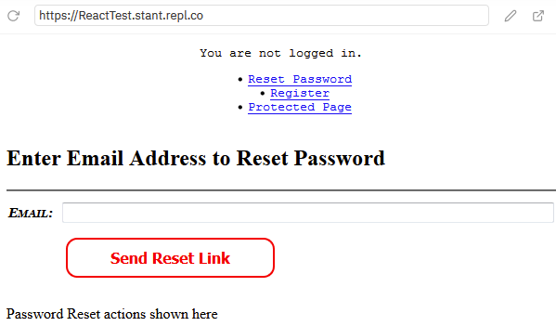
Password Reset Page

Slide 8
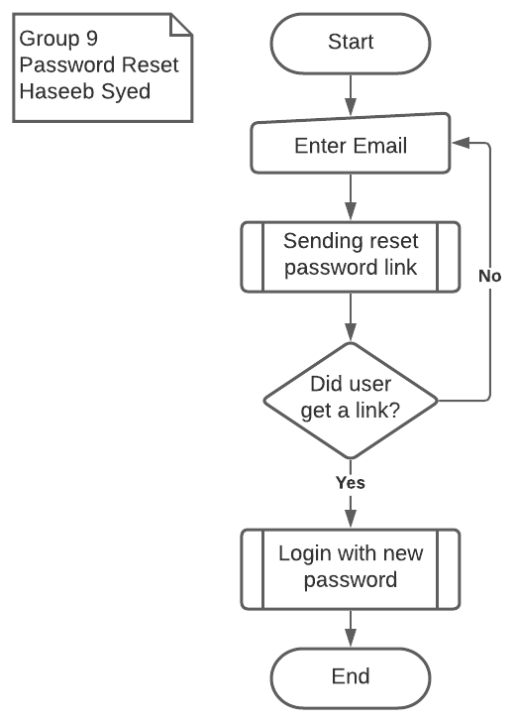
Password Reset Diagram

Slide 9
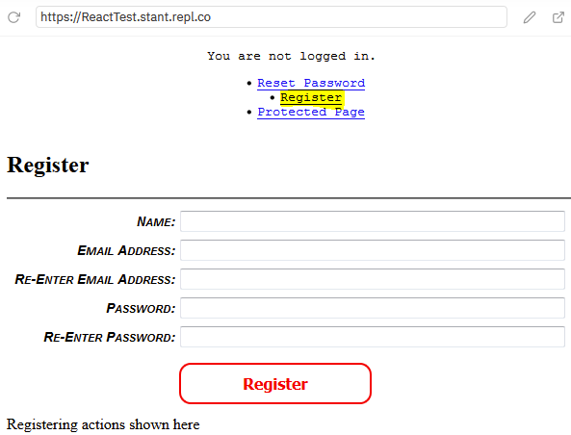
Registration Page

Slide 10
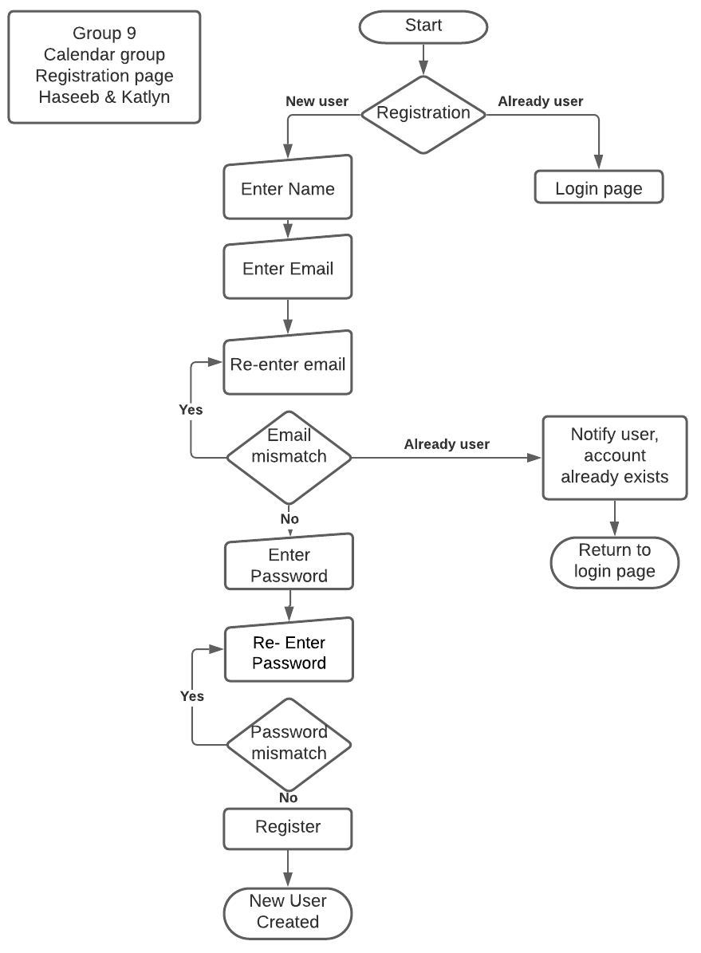
Registration Page Diagram

Slide 11
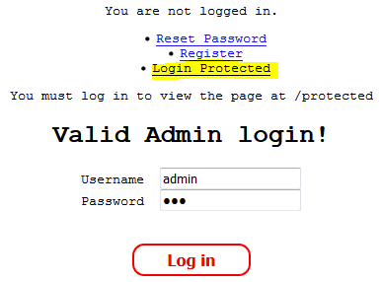
Login Protected Page In Use

Slide 12
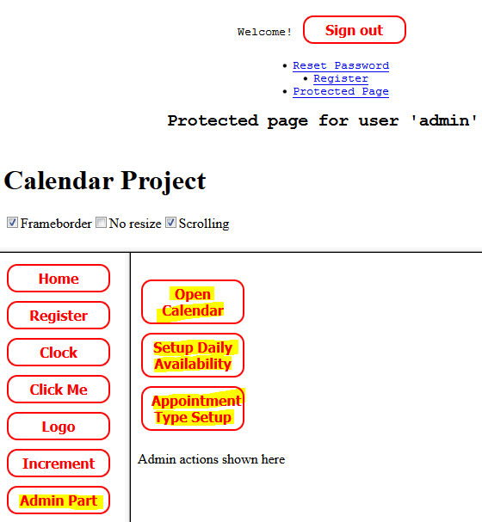
Admin Part Functions Page

Slide 13
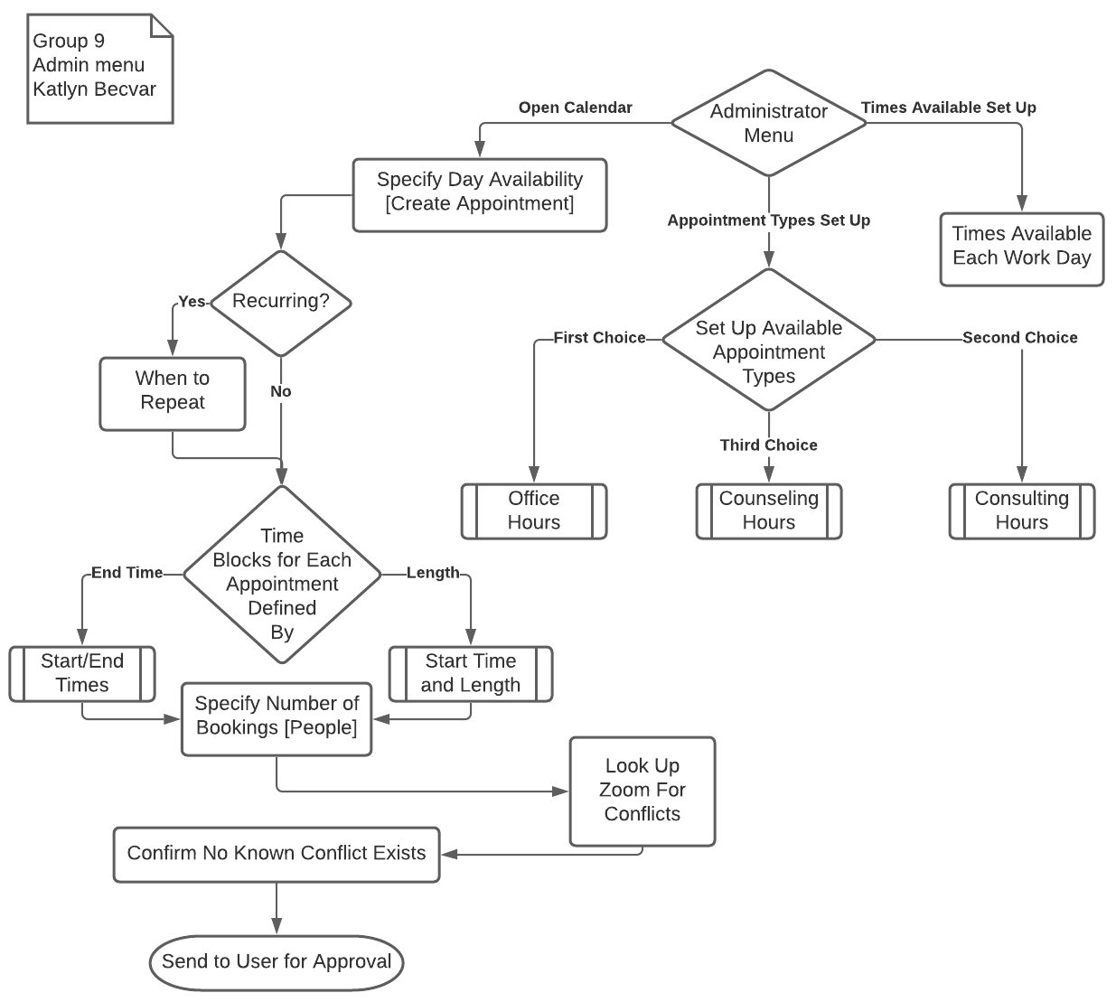
Admin Part Diagram

Slide 14
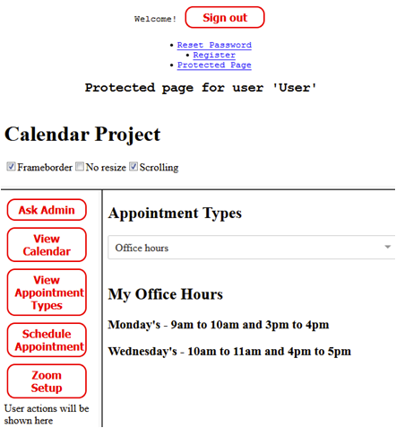
User Part Page

Slide 15
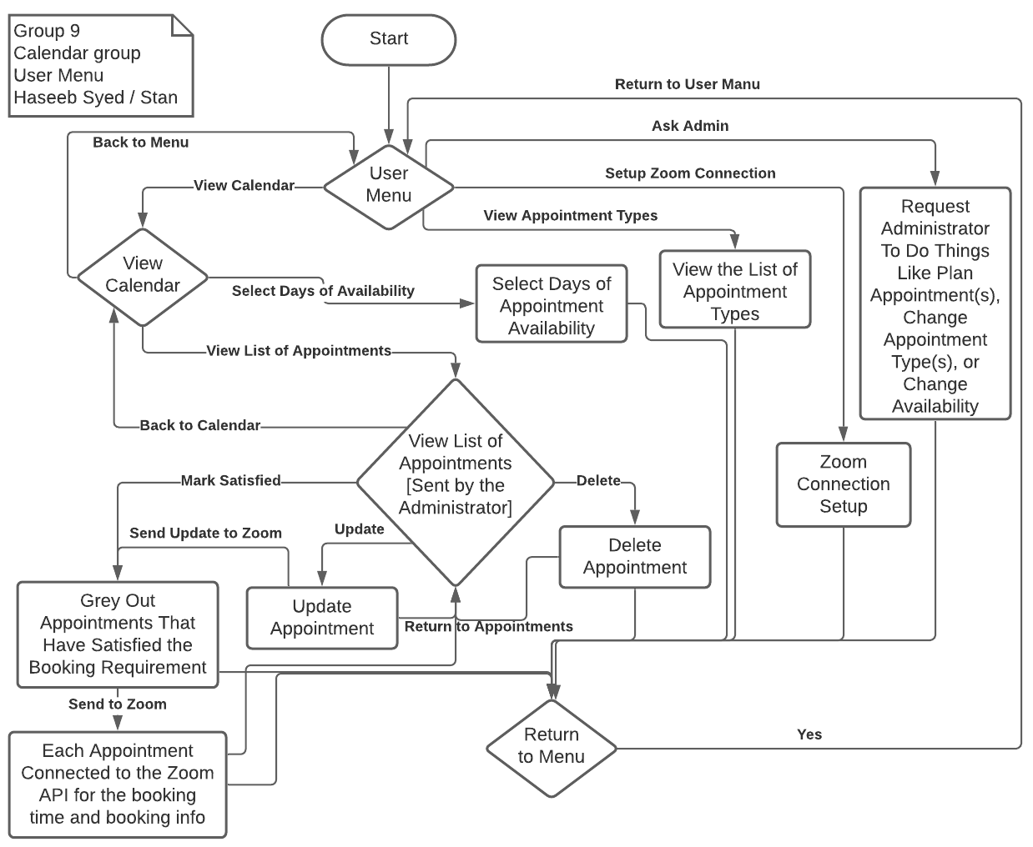
User Part Diagram

Slide 16
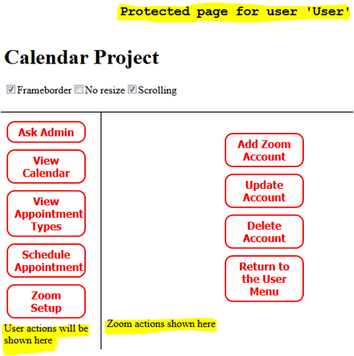
Zoom API Page

Slide 17
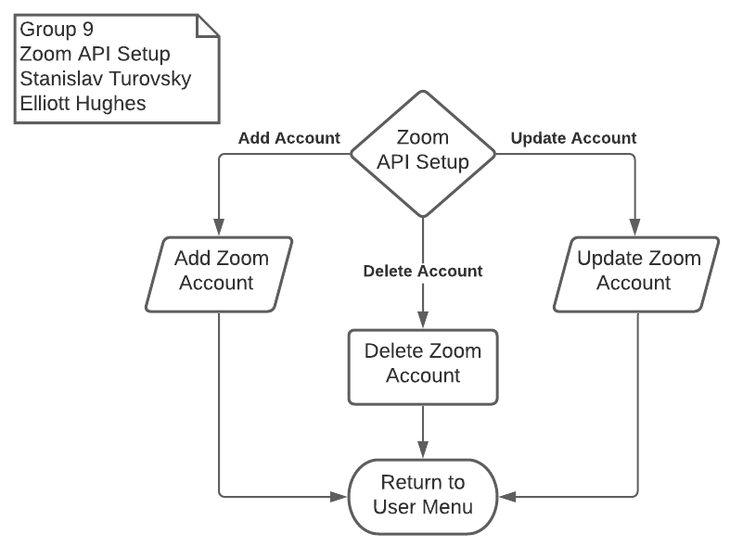
Zoom API Diagram

Slide 18
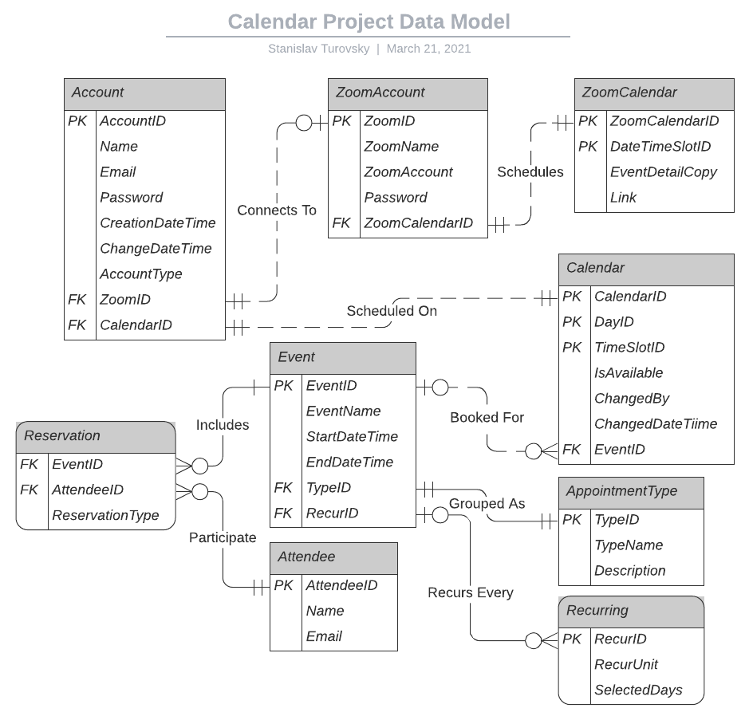
Data Model Diagram

Slide 19
Data Model Description 1of 3
The first entity is Account, that holds website’s Account, and besides its primary key AccountID, it holds account details such as user’s Name, Email, Password, Entry Creation and Change date/times, Account Type (such as User or Administrator), and 2 foreign keys to Zoom Account and Calendar entities.
Zoom Account entity’s, with its self-explanatory name, primary key is ZoomID, and it holds attributes of Zoom’s Name, Account number, Password, and one foreign key to Zoom Calendar entity. There should be none (such as for Administrator) or one (such as for a User) Zoom Account per a website’s Account.
Zoom Calendar entity’s, self-explanatorily named, primary key is merged from ZoomCalendarID and DateTimeSlotID, with Event Detail Copy containing virtually all details later emailed as a confirmation, and Link containing a separate copy of the meeting’s link for quick access purposes. Each Zoom Calendar has exactly one Zoom Account.

Slide 20
Data Model Description 2 of 3
Calendar entity holds the user’s calendar, and its primary key is merged from CalendarID, DayID, and TimeSlotID, with attributes being IsAvailable, ChangedBy, ChangeDateTime, and one foreign key to the Event entity. Calendar can have zero or many Events.
Event entity holds event details, and its primary key is EventID, and it holds attributes EventName, event Start and End date/times, and 2 foreign keys to AppointmentType and Recurring entities. Event can have exactly one appointment type and from zero to many recurrences, as well as from one to many attendee reservations.
Reservation entity is used to combine all possible combinations of events and attendees, and its primary key is merged from foreign keys to Event and Attendee entities. A reservation entry would have exactly one event and one attendee.

Slide 21
Data Model Description 3 of 3
Attendee entity holds all possible attendees, and its primary key is AttendeeID, with attributes of each attendee’s Name and notification Email address. Yes, in theory there could be multiple email addresses, but we are keeping it simple. Each attendee can be linked to from zero or many reservations.
AppointmentType entity holds all possible appointment types, and its primary key is TypeID, with attributes being appointment type’s name (TypeName) and Description. Each appointment type can be used in from zero or many events.
Recurring entity holds event recurrings, its primary key is RecurID, and its attributes are RecurUnit (such as a month or a week) and SelectedDays (such as 2 for “every 2nd day of the month” if the recurring unit is “month”).

Slide 22
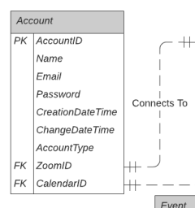
Account
Created by user.
Holds name, email, password, creation/change date/times, and account type.
Associated with ZoomID and CalendarID.

Slide 23
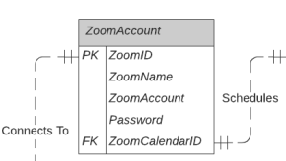
Zoom Account
Connects Zoom information to account.
Allows account to be used with Zoom, make appointments, etc.

Slide 24
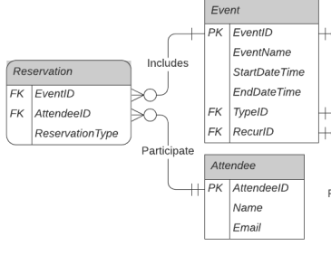
Reservations, Events, and Attendees
Reservation
Contains event ID, type of reservation, and attendees.
Event
Contains EventID, EventName, Start/End times.
Referred to with TypeID for type of event or RecurID if the event is recurring.
Attendee
- Contains attendee name and email address.

Slide 25
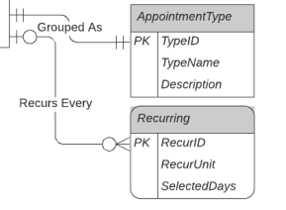
Appointments
Appointments are linked to “TypeID” and “RecurID” in the event container.
Appointment Type
Contains description of appointment and the type.
Recurring
Makes an appointment recurring.
Contains “Unit” for how often the schedule repeats.
Accepts the selected days to replicate.

Slide 26
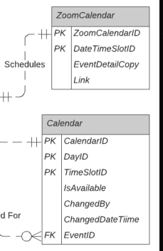
Calendars
ZoomCalendar
Interfaces with zoom account.
Holds necessary Calendar.
Calendar
Interfaces with Account.
Holds Calendar configuration info, availability and event ID.
Can be changed by user or Admin.

